Slide 1


Do financial literacy, risk attitude or time preference affect the chance of being overindebted?
Jonathan Crook
Credit Research Centre, University of Edinburgh
Presented at the University of Edinburgh Business School, 18 October 2024.
Financial support from the Leverhulme Trust is gratefully acknowledged.
All limitations and errors are the sole responsibility of the author.

Slide 2

Some Statistics
February 2024: 23% of survey respondents found keeping up with domestic
bills and credit card commitments a “heavy burden” or they had fallen behind by
3 months or more with payments. (Debt Justice 2024).
Financial Lives Survey: percentage of adults in UK in financial difficulty
rose from 8% in 2017 to 11% in 2023 (FCA 2023).
In England and Wales number of individual insolvences was 23% higher in
February 2024 than in February 2023 (The Insolvency Service 2024).

Slide 3
Aim and Structure
Aim
Introduction
Literature
Data
Methodology
Results
Conclusions

Slide 4
Contributions
.
First study to investigate directly the relationships between being overindebted and
  risk attitude
  time preference rate
We explore the effects of financial literacy with a much larger sample than previous literature
Unlike much literature we make inferences about the adult population
Largest recent study on overindebtedness for GB for over 12 years

Slide 5
Empirical Household or Personal Indicators of Overindebtedness
No commonly accepted definition
EC (2014) :
A HH is overindebted if, on an ongoing basis it finds it difficult to pay its commitments including meeting
payments for any type of debt or the payments of rent, utility or household bills.
Indicator Group | Example
Debt Service Ratios (DSR) | Individual spends > X% of (gross/net ) monthly income on total borrowing repayments (for secured and unsecured loans) (X typically = 50%)
 | Individual spends >X% of (gross/net) monthly income on secured loans (X typically = 25%, 30%, 50%)
Affordability | Borrowing repayments takes the Individual “below the poverty line”
Delinquency | Individual is > A months in arrears on credit commitments or bills (A typically =2)
# Loans | If individual has more that Z credit commitments (Z typically =4)
Perception of debt burden | Individual reports repayments are a “heavy burden” Individual reports difficulty in paying unexpected bills
Adapted from D’Alessio & Lezzi (2013).
Weaknesses with all.

Slide 6
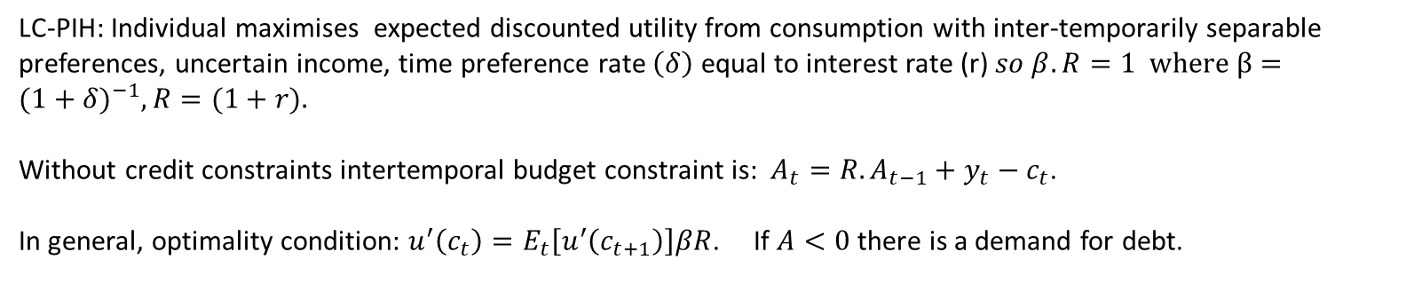
Literature: Permanent Income Hypothesis 1
LC-PIH: Individual maximises expected discounted utility from consumption with inter-temporarily separable
preferences, uncertain income, time preference rate $\left(δ\right)$ equal to interest rate (r) $so β.R=1 where β={(1+δ)}^{−1}, R=(1+r).$
Without credit constraints intertemporal budget constraint is: $A_{t}=R.A_{t−1}+y_{t}−c_{t}$.
In general, optimality condition: $u^{′}\left(c_{t}\right)=E_{t}\left[u^{′}\left(c_{t+1}\right)\right]βR$. If $A<0$ there is a demand for debt.
If income is expected to increase reduces savings or borrows.
£
Borrow Repay
C
Y
Age

Slide 7
Literature: Permanent Income Hypothesis 2
In the PIH: PV _{expected consumption} = PV _{expected income} and expected repayments are taken into account when choosing consumption in
each period.
In PIH there is no expected overindebtedness
If are unexpected reductions in income and as a result permanent income falls then expected permanent income may be insufficient
to pay current and future debts so consumption would be reduced and overindebtedness occurs.
Same if unexpected increases in consumption.

Slide 8
Literature: Unexpected shocks
Causes of unexpected income shocks:
poor health,
loss of job,
relationship breakdown,
price inflation exceeding nominal income inflation,
loss of capital income,
unexpected increase in cost of servicing debt.
Similarly unexpected consumption increases can increase debt/assets ratio.
Possible causes of unexpected consumption increases:
Poor health
Physical capital (appliances, car ) breakdown
Debt relative to assets may increase for other reasons

Slide 9
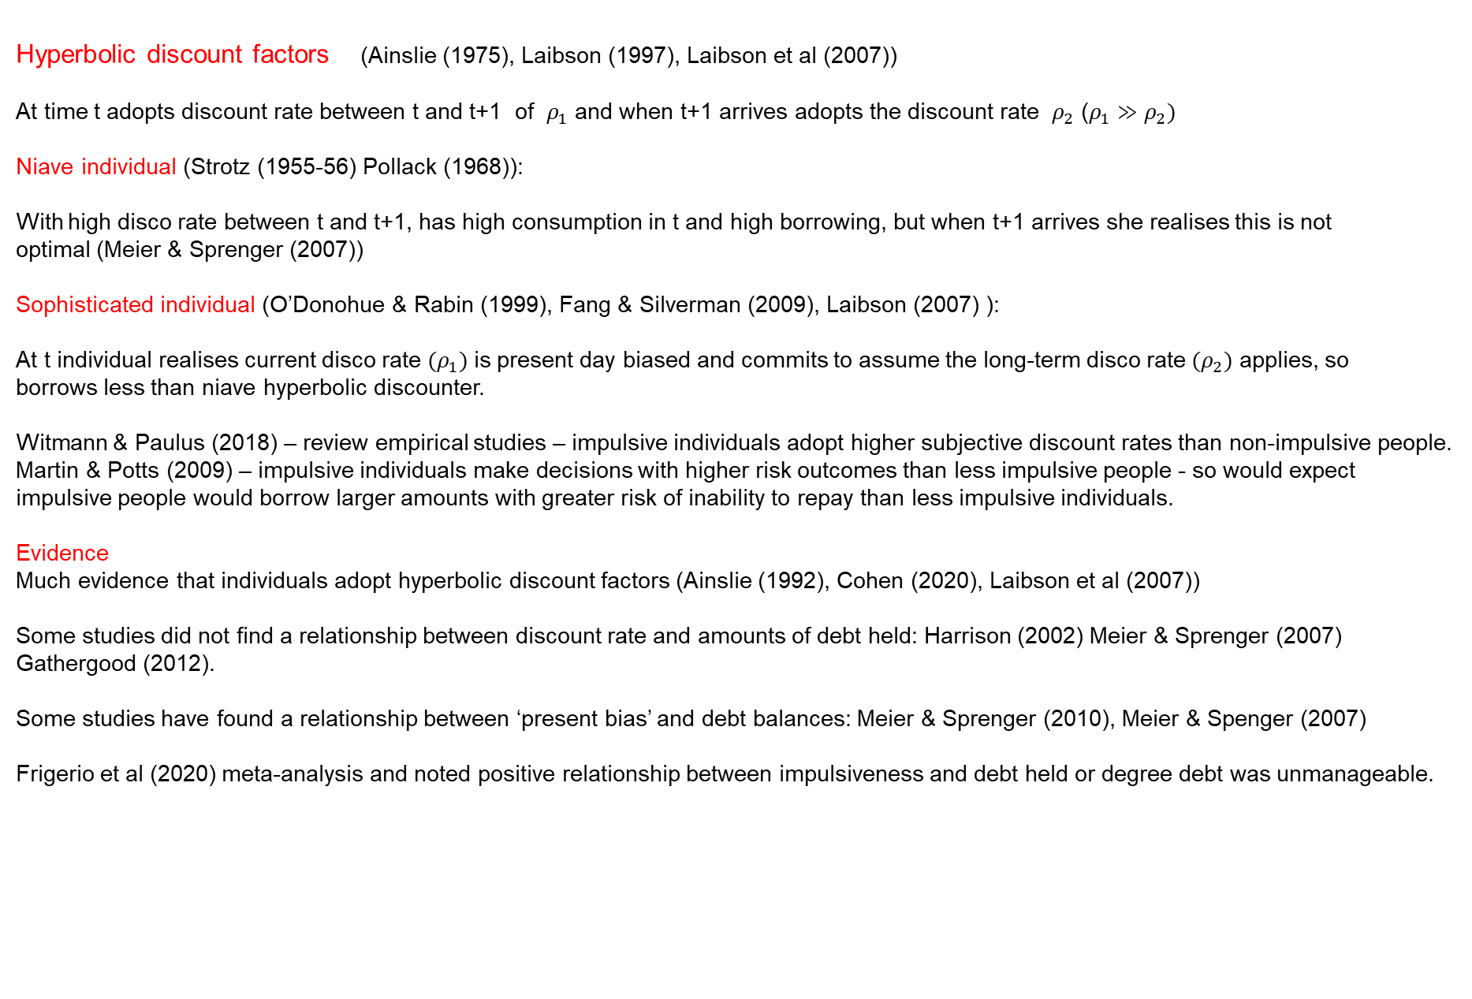
Literature: Approaches outside of the PIH 1
Hyperbolic discount factors (Ainslie (1975), Laibson (1997), Laibson et al (2007))
At time t adopts discount rate between t and t+1 of $ρ_{1}$ and when t+1 arrives adopts the discount rate $ρ_{2}$ ($ρ_{1}≫ρ_{2})$
Niave individual (Strotz (1955-56) Pollack (1968)):
With high disco rate between t and t+1, has high consumption in t and high borrowing, but when t+1 arrives she realises this is not
optimal (Meier & Sprenger (2007))
Sophisticated individual (O’Donohue & Rabin (1999), Fang & Silverman (2009), Laibson (2007) ):
At t individual realises current disco rate ${(ρ}_{1})$is present day biased and commits to assume the long-term disco rate ${(ρ}_{2})$ applies, so
borrows less than niave hyperbolic discounter.
Witmann & Paulus (2018) – review empirical studies – impulsive individuals adopt higher subjective discount rates than non-impulsive people.
Martin & Potts (2009) – impulsive individuals make decisions with higher risk outcomes than less impulsive people - so would expect
impulsive people would borrow larger amounts with greater risk of inability to repay than less impulsive individuals.
Evidence
Much evidence that individuals adopt hyperbolic discount factors (Ainslie (1992), Cohen (2020), Laibson et al (2007))
Some studies did not find a relationship between discount rate and amounts of debt held: Harrison (2002) Meier & Sprenger (2007)
Gathergood (2012).
Some studies have found a relationship between ‘present bias’ and debt balances: Meier & Sprenger (2010), Meier & Spenger (2007)
Frigerio et al (2020) meta-analysis and noted positive relationship between impulsiveness and debt held or degree debt was unmanageable.

Slide 10
Literature: Approaches outside the PIH 2
Financial literacy
PIH assumes individuals act as if have sufficient knowledge to make financially optimising decisions.
In practice: unlikely.
Evidence
Gathergood (2012): correct answers to 2 out of 3 questions negatively related to being one month but not 3 months behind (UK)
Lusardi & Tufano (2015): loose relationship.(US)
French & McKillop (2016) : better numeracy and poorer money management skills were causes of high debt: income ratios (NI)
Hamid & Loke (2021): money management skills and financial literacy were positively associated with repaying credit card debt
in full (Malaysia).
Kurowski (2021) financial knowledge negatively related to saying had too much debt or repayment difficulties (Poland)
Weaknesses:
Omit possibility that the measure of overindebtedness may be low or zero because the respondent does not have debt
Few control for risk attitude or discount rate.

Slide 11
Literature: Approaches outside the PIH 2
Attitude towards Risk
Traditional expected utility theory: choose action with highest expected utility.
If marginal utility of consumption declines at higher levels of consumption – risk averse
So less likely to take actions with risky outcomes than a risk neutral person (expected utility is lower for risk averse person)
Borrowing is risky so risk aversion person less willing to borrow than risk neutral person.
Counterviews:
If individual expects a negative income shock a risk averse person may take very large amounts of debt (so being overindebted)
because she is consumption smoothing. (Lagomarsono & Spiganti (2023))
Prospect theory:
Individuals are risk averse to potential gains but risk seekers concerning potential losses. (Kahneman & Tversky (1979))
People typically prefer A: £600 p=1 to B: {£1200 p=0.5 or £0 p=0.5} BUT prefer C: {£-1200 p=0.5 or £0 p=0,5} to D: £-600 p=1
So more likely to accept risk of losses so more likely to take on excessive debt than under expected utility hypothesis.
Evidence
Little relationship Blanquez et al (2020), Meyll & Pauls (2019))
Positive relationship Nagano & Yeom (2014)
But in all 3 studies the measures of risk aversion are problematic.

Slide 12
Data
Round 7 of Wealth and Assets Survey (EUL version) – ONS (only round with financial literacy questions)
Data collected at household and individual level
Respondents lived in England, Wales & Scotland (south of the Caledonian Canal)
Respondents were aged 16+ and not in FT education.
Wealthy are oversampled.
Deleted cases: where interview was not in person, if less than a full or partial interview, some extreme values,
had non-positive net income, if any variables had a missing value.
Consider only overindebtedness on cards, credit agreements, overdrafts, loans and bill payments (not mortgages).
WAS is good choice because:
Can compute several different measures of overindebtedness (many studies use only one)
Is largest UK survey that allows this (sample sizes we use are dramatically larger than any of the published studies)
Sample selected to be representative of population of GB
Is the only recent survey that includes financial literacy
Has large number of relevant socio-demographics to act as controls.

Slide 13
Measures of “Overindebtedness”
Burden
“Now thinking about the mortgage or loans secured on your property in addition to these payments, to what extent is
keeping up with all of the repayments and interest payments a financial burden to your household?
A heavy burden/somewhat of a burden/ Or not a problem at all ?”
Missed 2
“Have you been able to keep up with the repayments for the instalments on [this catalogue/these catalogues] or
are you 2 or more consecutive payments behind?
Debt service ratio (DSR) 30%
Computed as: If (total repayments / net income) > 30%

Slide 14
Questions on risk aversion, discount rate and financial literacy
Financial Literacy
“If the inflation rate is 5% and the interest rate you get on your savings is 3%, will your savings have more, less or
the same amount of buying power in a year’s time?”
2. SHOWCARD: standard bank statement. “Looking at this example of a bank statement, please can you tell me how much money was in the account at the end of February?”
“Suppose you put £100 into a savings account with a guaranteed interest rate of 2% per year. You don’t make any further payments into this account and you don’t withdraw any money. How much money would be in the account at the end of the first year, once the interest payment is made?”
Discount Rate
“If you had a choice of receiving a thousand pounds today and one thousand one hundred pounds in 12 months time,
which would you choose?”
Risk aversion
“If you had a choice between a guaranteed payment of one thousand pounds and a one in five chance of winning
ten thousand pounds, which would you choose?”

Slide 15
Control variables
From the literature:
Age 15-24 Age 25-34 Age 35-44 Age 45-54 Age 55-64 Male Single Divorced or separated Has undergrad degree | Has dependent children. Owns or rents accommodation Is unemployed Is self employed Log(real net income) Real total benefits received Repayments/net income Log(real net worth) Has bad health Has long-standing illness

Slide 16
Econometric Strategy
Questions on burden of repayments and on whether missed two payments asked only to those with debt.
Observations may be MNAR because those without debt may have been rejected by lenders because lender expected applicant to become overindebted or did not apply because thought would be unable to repay.
Used Heckman sample selection estimators.
Sample selection equation: whether has debt or not.
Assume probit model. Implement ML estimators as in Van de Ven & Van Praag (1981).
Identification Strategy:
Being a single parent expected to increase demand for debt, but conditional on other characteristics is not expected to affect whether holds so much debt that feels overindebted.
Having qualifications other than an undergraduate degree expected to affect whether has debt but not whether is overindebted.
Neither significant in overindebtedness probit but highly significant in has debt equation.

Slide 17
Summary statistics
 | Total | Those who have debt
 |  | Find payts. a burden | Do not find a burden
# in sample | 25,330 | 3,587 | 14,029
Implied population size | 37,324,397 | 6,905,842 | 18,493,174
Time pref rate (% preferring £1000 today) | 71.04 | 81.04 | 64.61
Risk attitude (% taking guaranteed £1000) | 81.13 | 81.98 | 78.55
Fin Lit 1: Understanding real interest (%correct) | 75.24 | 70.06 | 82.23
Fin Lit 2: Understanding bank statement (% correct) | 85.10 | 85.23 | 88.83
Fin Lit 3: Understanding interest (% correct) | 81.15 | 78.51 | 87.40
Have debt (%) | 68.05
Cases are weighted by population sampling weights. Sample consists of all individuals who were interviewed in person and for whom there was a full or partial interview and for whom there
were no missing values for any of the variables in the list and who had repayments/net income of less than the 99.75th percentile.

Slide 18
Overindebtedness models with risk attitude, discount rate and literacy
 | Repayments are a heavy or somewhat heavy burden | Missed two consecutive payments | Debt-service ratio > 30%
Time preference rate | 0.329** | 0.224* | 0.267**
 | (0.028) | (0.113) | (0.036)
Risk attitude | 0.151** | -0.040 | 0.023
 | (0.031) | (0.105) | (0.039)
FL1: Real interest understanding | -0.047 | -0.117 | 0.024
 | (0.033) | (0.101) | (0.044)
FL2: Bank statement understanding | -0.038 | 0.105 | 0.075
 | (0.039) | (0.138) | (0.053)
FL3: Interest understanding | -0.060 | -0.070 | 0.042
 | (0.037) | (0.113) | (0.051)
No observations | 25,330 | 24,210 | 25,336
No selected | 17,616 | 10,115 | 17,088
No not selected | 7,714 | 14,095 | 8,248
Wald Chi-squared | 2,495** | 205** | 676**
Rho (e1,e2) | 0.331** | 0.107 | 0.272
Controls | Yes | Yes | Yes
Sample seln equation | Yes | Yes | Yes

Slide 19
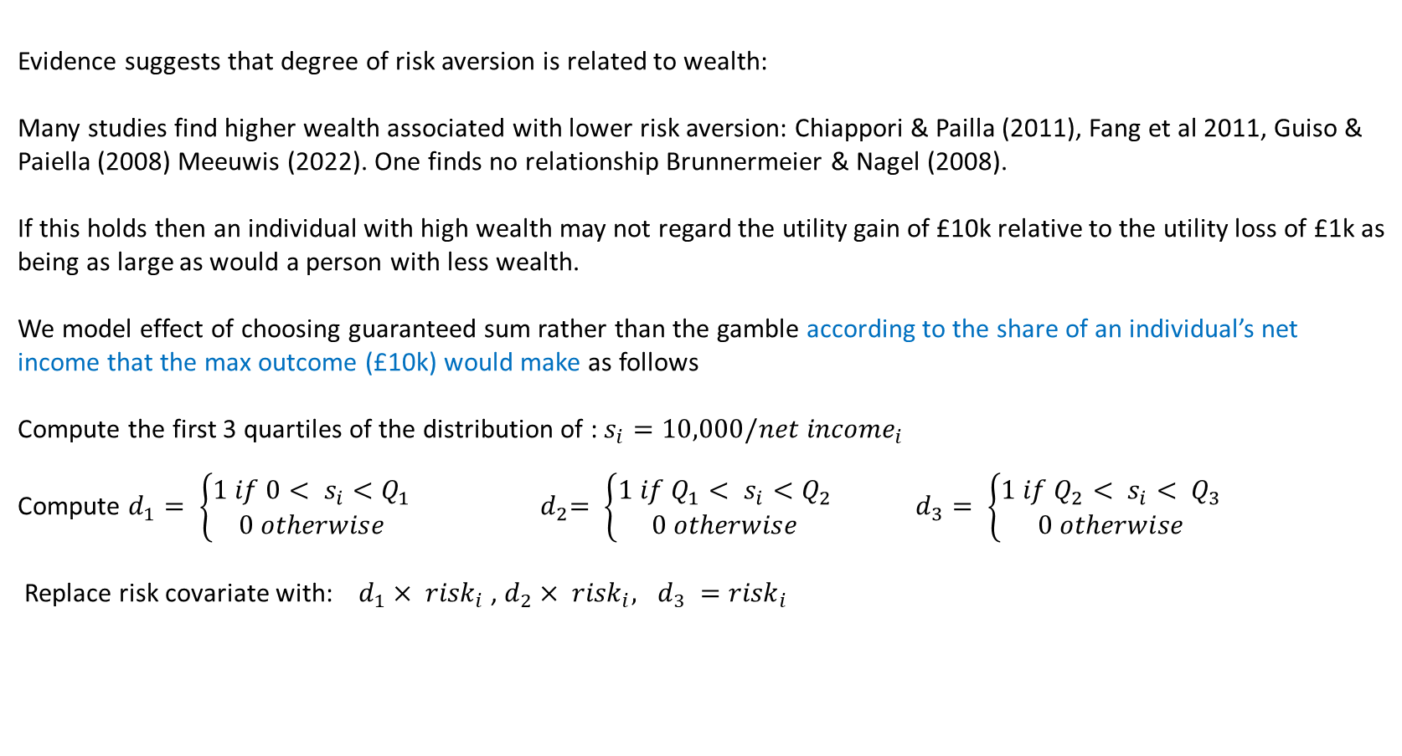
Extensions: Risk attitude
Evidence suggests that degree of risk aversion is related to wealth:
Many studies find higher wealth associated with lower risk aversion: Chiappori & Pailla (2011), Fang et al 2011, Guiso & Paiella (2008) Meeuwis (2022). One finds no relationship Brunnermeier & Nagel (2008).
If this holds then an individual with high wealth may not regard the utility gain of £10k relative to the utility loss of £1k as being as large as would a person with less wealth.
We model effect of choosing guaranteed sum rather than the gamble according to the share of an individual’s net income that the max outcome (£10k) would make as follows
Compute the first 3 quartiles of the distribution of : $s_{i}=10,000/{net income}_{i}$
Compute $d_{1}= \left\{\begin{aligned}1 if 0< s_{i}<Q_{1} \\ 0 otherwise\end{aligned}\right.$ ${ d}_{2}= \left\{\begin{aligned}1 if Q_{1}< s_{i}<Q_{2} \\ 0 otherwise\end{aligned}\right.$ $d_{3}= \left\{\begin{aligned}1 if Q_{2}< s_{i}< Q_{3} \\ 0 otherwise\end{aligned}\right.$
Replace risk covariate with: $d_{1}× {risk}_{i}$ , $d_{2}× {risk}_{i}, d_{3} ={risk}_{i}$

Slide 20
Overindebtedness models interaction risk attitude with income quartiles
Coefficients | Repayments are a heavy or somewhat heavy burden | Missed two consecutive payments | Debt-service ratio > 30%
 |  |  | **
Time preference rate | 0.330** | 0.235* | 0.271**
 | (0.028) | (0.114) | (0.036)
First income share quartile x risk attitude | -0.012 | -0.051 | -0.196**
 | (0.040) | (0.153) | (0.052)
Second income share quartile x risk attitude | 0.066* | -0.195 | -0.115**
 | (0.033) | (0.122) | (0.044)
Third income share quartile x risk attitude | 0.092** | -0.055 | 0.017
 | (0.033) | (0.109) | (0.042)
FL1: Real interest understanding | -0.046 | -0.118 | 0.025
 | (0.033) | (0.102) | (0.044)
FL2: Bank statement understanding | -0.041 | 0.108 | 0.069
 | (0.039) | (0.139) | (0.054)
FL3: Interest understanding | -0.059 | -0.073 | 0.043
 | (0.037) | (0.114) | (0.052)
No observations | 25,330 | 24,210 | 25,336
No selected | 17,616 | 10,115 | 17,088
No not selected | 7,714 | 14,095 | 8,248
Wald Chi-squared | 2,503** | 209** | 686**
Rho (e1,e2) | 0.324** | 0.090 | 0.238
Controls | Yes | Yes | Yes
Sample seln equation | Yes | Yes | Yes

Slide 21
Overindebtedness models interaction risk attitude with income quartiles
Pr (repayts burden)
Non-linear relationship
x
x
x
x
Relative risk aversion
Low High
Pr (DSR>30%)
x
x
x
Increase from low to high
x
Relative risk aversion
Low High

Slide 22
Overindebtedness and degree of financial knowledge (burden indicator)
Are there systematic effects of giving the wrong answers to the financial literacy questions, in particular directions?
Low level of knowledge
Inflation question Bank statement Interest rate:
DI1 = 1 if response was “more”; 0 otherwise DB1=1 if overestimate; 0 otherwise DR1=1 if overestimate; 0 otherwise
DI2 = 1 if response was “same”; 0 otherwise DB2=1 if correct answer; 0 otherwise DR2=1 if correct answer; 0 otherwise
DI3 = 1 if response was “less”; 0 otherwise DB3=1 if underestimate; 0 otherwise DR3=1 if underestimate; 0 otherwise
DI4 = 1 if “don’t know or refusal”; 0 otherwise DB4=1 if don’t know or refusal; 0 otherwise DR4=1 if don’t know or refusal; 0 otherwise
Estimate three probit equations, each with controls plus one set of dummies
2) Good level of knowledge
Created 3 dummies each =1 if two questions answered correctly; 0 otherwise
DIB=1 if inflation and bank questions both correct; 0 otherwise
DIR=1 if inflation and interest rate questions both correct; 0 otherwise
DIR=1 if bank and interest rate questions both correct; 0 otherwise
One probit on controls plus all 3 dummies
3) Very good level of knowledge
Created one dummy =1 if all three questions correct; 0 otherwise
One probit on controls plus this dummy

Slide 23
Overindebtedness and degree of financial knowledge (burden indicator)
Panel A Models with each knowledge indicator separately
 | Real interest understanding |  | Bank statement understanding | Interest understanding
D1 (more) | 0.040 | D1 (overestimate) | -0.032 | 0.096
 | (0.065) |  | (0.063) | (0.049)
D2 (same) | 0.015 | D2 (correct) | omitted | Omitted
 | (0.054)
D3 (correct) | Omitted | D3 (underestimate) | 0.104 | -0.072
 |  |  | (0.066) | (0.086)
D4 (don’t know or refusal) | 0.089 | D4 (don’t know or refusal) | 0.068 | 0.101*
 | (0.038) |  | (0.058) | (0.050)
No observations | 25,330 |  | 25,330 | 25,330
No selected | 17,616 |  | 17,616 | 17,616
No not selected | 7,714 |  | 7,714 | 7,714
Wald Chi-squared | 2,416** |  | 2,396** | 2,435**
Rho (e1,e2) | 0.379** |  | 0.392** | 0.369**
Controls | Yes |  | Yes | Yes
Sample seln equation | Yes |  | Yes | Yes

Slide 24
Analysis of individual response levels for financial literacy measures (burden indicator)
Panel B Good level of knowledge
Both inflation and bank statement questions correct | -0.041
 | (0.039)
Both inflation and interest questions correct | -0.020
 | (0.039)
Both bank statement and interest questions correct | -0.052
 | (0.037
No observations | 25,330
No selected | 17,616
No not selected | 7,714
Wald Chi-squared | 2,500**
Rho (e1,e2) | 0.327**
Controls | Yes
Sample seln equation | Yes
Panel C Very good level of knowledge
Answers to all three questions correct | -0.083**
 | (0.028)
No observations | 25,330
No selected | 17,616
No not selected | 7,714
Wald Chi-squared | 2,462**
Rho (e1,e2) | 0.349**
Controls | Yes
Sample seln equation | Yes

Slide 25
Results for control variables
 | Repts heavy or somewhat heavy burden | Missed 2 consecutive payments | DSR>30%
Age 15-24 | 0.617** | 1.161** | -0.115
Age 25-34 | 0.913** | 0.845** | 0.195*
Age 35-44 | 0.927** | 0.806** | 0.306*
Age 45-54 | 0.845** | 0.814** | 0.322**
Age 55-64 | 0.575** | 0.646** | 0.171**
Male | 0.056** | 0.167 | 0.065*
Single | 0.218** | 0.184 | -0.146**
Divcd or sep. | 0.502** | 0.228 | 0.072
Undergrad degree | -0.117** | -0.090 | -0.012
 | Repts heavy or somewhat heavy burden | Missed 2 consecutive payments | DSR>30%
Dep children | 0.395** | -0.017 | 0.240**
Owns or rents | 0.165** | 0.280 | 0.092
Unemployed | 0.309** | 0.284 | 0.181
Self empl | 0.086* | -0.053 | 0.175**
Log (net inc) | -0.026 | -0.122 | -0.141**
Total benefits | + ** | + ** | - **
Repayts/net inc | 1.235** | 0.451**
Log (net wealth) | -0.076** | -0.041** | -0.042**

Slide 26
Example of selection equation
 | Repayments are a heavy or somewhat heavy burden | Missed two consecutive payments | Debt-service ratio > 30%
Age 25-54 | 0.159** | 0.300** | 0.101**
Single | -0.240** | -0.049 | -0.274**
Divorced or separated | -0.089** | 0.204** | -0.142**
Single parent | 0.282** | 0.174** | 0.215**
Is self employed | 0.035 | 0.051 | 0.18x10-2
Real net income | 0.045** | 0.024** | 0.049**
Real total benefits received | -0.13 x 10-3** | -0.21x 10-3** | -0.16x10-3**
Has undergraduate degree | 0.742** | 0.542** | 0.748**
Has qual other than degree | 0.447** | 0.405** | 0.429**
Has dependent children | -0.026 | 0.120** | -0.043
Owns or rents accomodation | 0.417** | 0.291** | 0.381**
 | Repayments are a heavy or somewhat heavy burden | Missed two consecutive payments | Debt-service ratio > 30%
Log (real net wealth) | 0.015** | -0.52 x 10-2 | 0.031**
FL1 Real interest understanding | 0.121** | 0.054* | 0.137**
FL2 Bank statement understanding | 0.228** | 0.162** | 0.218**
FL3 Interest understanding | 0.145** | 0.086** | 0.156**
No observations | 25,330 | 24,210 | 25,336
No selected | 17,616 | 10,115 | 17,088
No not selected | 7,714 | 14,095 | 8,248
Wald Chi-squared | 2,503** | 205** | 676**
Rho (e1,e2) | 0.324** | 0.107 | 0.272

Slide 27
Conclusions
Only those with a relatively high level of financial literacy have a lower chance of perceiving debt payments to be a burden
Modest or basic financial knowledge have no detectable effect. Similar to Gathergood (2012), different from Lusardi & Tuffano (2015)
Individuals with a basic level of financial knowledge ae more likely to hold debt than those with less knowledge.
There is a concave relationship between risk aversion and repayments being a perceived burden whilst less risk averse individuals
have a lower chance of a high debt : income ratio. (consistent with Lagomarsino and Spiganti (2023).
Those with a relatively high discount rate are more likely to be overindebted – on all three measures. Consistent with hypothesis that
hyperbolic discounters more likely to be overindebted than exponential discounters.

Slide 28
Reference
J. Crook (2024) Do Financial literacy, risk attitude or time preference affect the chance of being overindebted?
Under submission.

Slide 29
Thank you.
j.crook@ed.ac.uk

